Slide 1
Tulkotāja “prasmju čemodāns”.
Vakar, šodien
un rīt

Slide 2
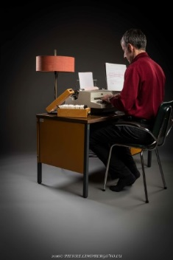
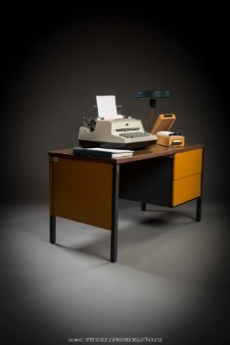
Tulkošana «akmens» laikmetā

Slide 3
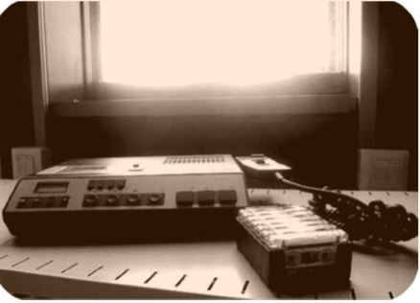
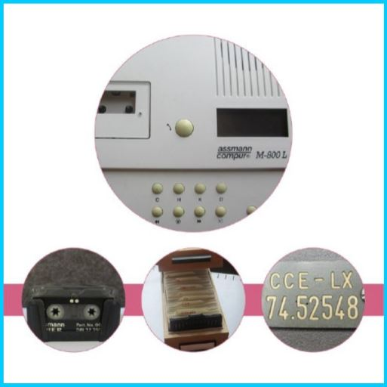

Slide 4
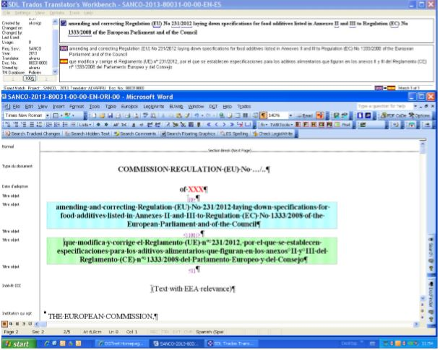
TWB jeb Translators Workbench ēra
Word dokumenti – TWB

Slide 5
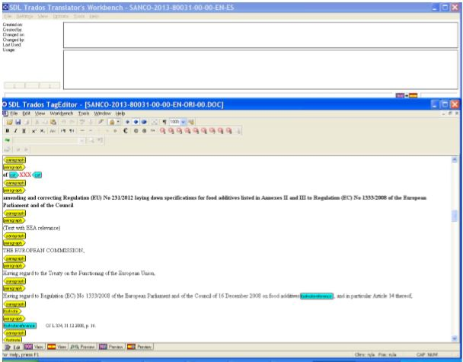
TWB jeb Translators Workbench ēra
Citi formāti (Excel, Powerpoint, HTML, XML) – SDL Trados TagEditor

Slide 6
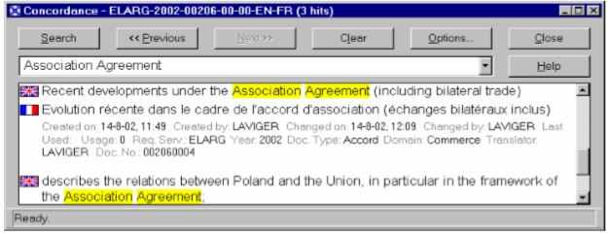
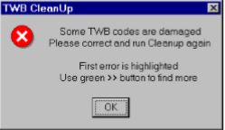
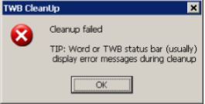
TWB jeb Translators Workbench ēra

Slide 7

Tulkošanas rīki
  IATE (public) –
  EUR-Lex (public)
  CAT un Studio
  eTranslation
  Euramis
  Quest Metasearch
  DGT Vista IDOL
  Dictionaries, glossaries
Image from rawpixel.com

Slide 8
Darbplūsma un tās rīki
Autors nosūta tulkošanas pieprasījumu
POETRY
Plānošanas nodaļa pieņem pieprasījumu
ManDesk
Tulkotājs izveido tulkošanas datni
TraDesk
Tulkotājs iztulko dokumentu
Word, CAT, Excel, HTML, XML…

Slide 9
Darbplūsma un tās rīki
Tulkotājs Nr. 2 pārlasa tekstu un tulkotājs Nr.1 izlabo tekstu
Gatavo tulkojumu augšuplādē sistēmā un arhivē
TraDesk + Euramis
Tulkojumu nosūta autoram

Slide 10
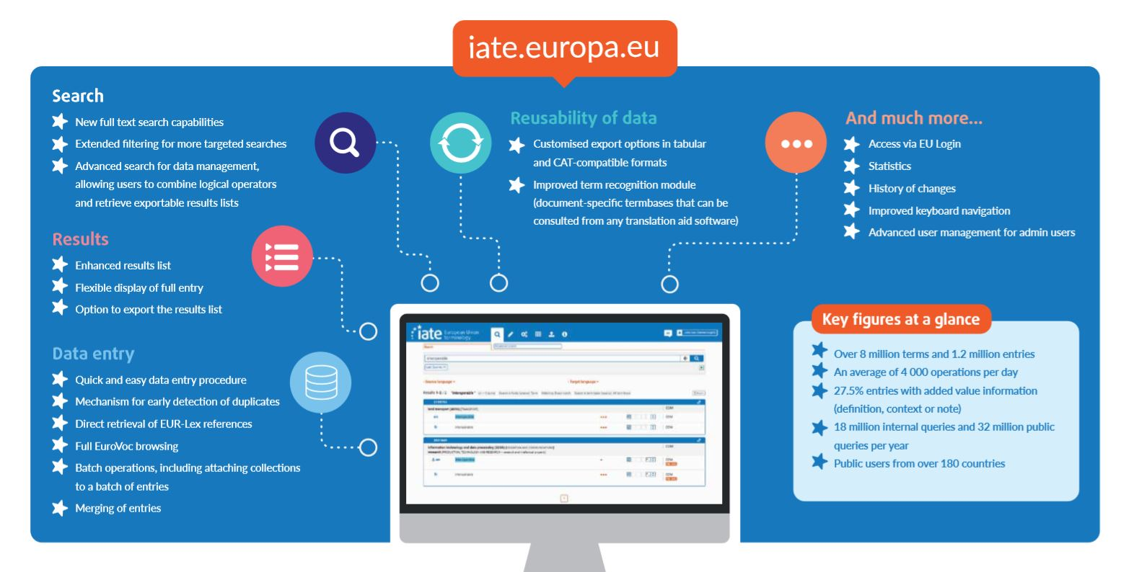
IATE –
Interactive Terminology for Europe

Slide 11
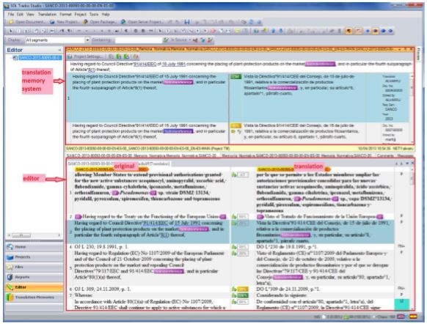
CAT un STUDIO

Slide 12
Tulkošanas atmiņas, xcliff faili un terminu bāzes
Euramis
retrieval
e-translation
manual alignment
download from Eur-Lex
TRM pieprasījumi IATE
terminu bāzes – IATE eksporti un pašu lietotāju sagatavotas terminu bāzes

Slide 13
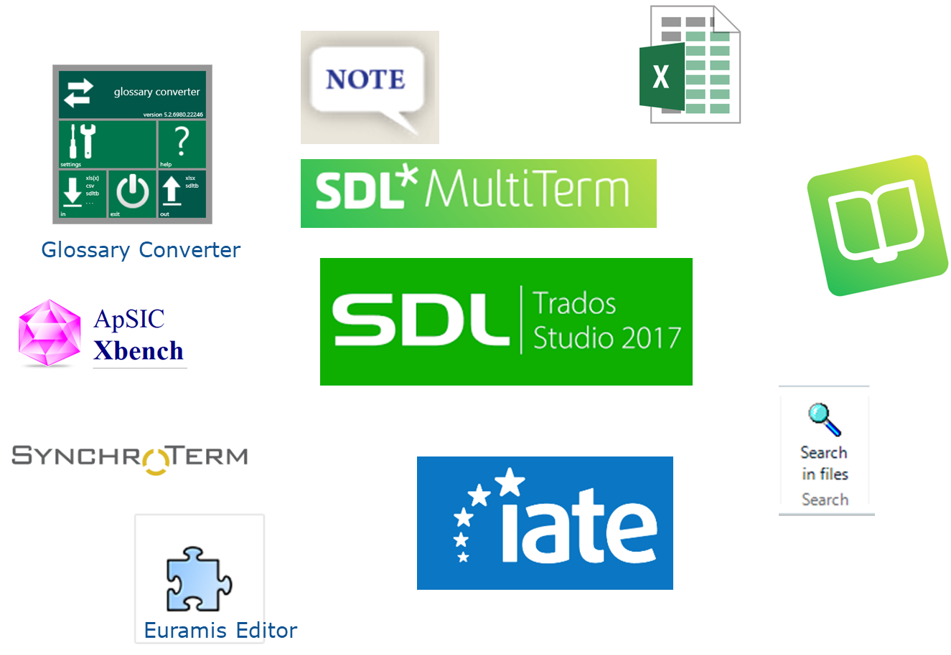
Terminoloģijas rīki

Slide 14
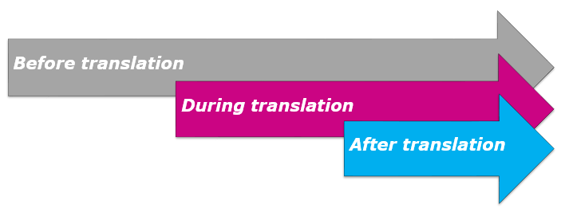
Terminoloģijas rīki dažādos darba posmos
Pirms tulkošanas
Tulkošanas laikā
  IATE TRM
  pilns IATE eksports
  filtrēts IATE eksports (vajadzīgie domēni)
Pēc tulkošanas
  Terminu meklēšana (Quest/IATE)
  Automātiska terminu atpazīšana pievienotā terminu bāzē
  Tukšas vai tematiskas terminu bāzes aizpildīšana tulkošanas gaitā
  Konsekvences pārbaudes
  Consistency checks
  Note/Elise: Add terms
  Converting TB to Excel if new terms should be added/modified in IATE

Slide 15
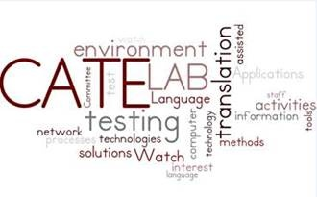
Papildrīki
CATE Lab:
jaunas programmatūras un rīku testēšana
testēšanas rezultātu apspriešana
jaunas programmatūras un jaunu rīku ierosināšana testēšanai
dažādu tulkošanas procesā iesaistīto dalībnieku vajadzību noteikšana
Pašu tulkotāju programmētie rīki

Slide 16
Mašīntulkošana
Eiropas pusgads — instruments, lai ES dalībvalstīs situācija būtu skaida.
The European semester: the tool to keep EU Member States in the all-clear.
Tai ir mērķis likvidēt birokrātiju un pazemināt izmaksas, neapdraudot pilotiskos mērķus un nepazeminot augstos ES standartus.
It targets removing red tape and lowering costs without compromising policy objectives and EU high standards.

Slide 17
Mašīntulkošana
es vēlos pierādīt, ka pētniecība un inovācija var būtiski apgrūtināt lielas iespējas.
I want to demonstrate that research and innovation can turn major challenges into major opportunities.
Tāpēc ir būtiski nodrošināt mūsu zinātniekiem tiesības brīvi iepazīties ar zināšanu robežām.
That is why it is essential to give our scientists some freedom to explore the frontiers of knowledge.

Slide 18
Mašīntulkošana
Viņa kļuva par cīnītāju pret marginalizētām un trūcīgām personām. [slavenā holandiete Marga Klompē]
She went on to become a champion of the marginalised and underprivileged.
Fikcijas, piemēram, par sociālo plašsaziņas līdzekļu aizsardzību, piemēram, par savvaļas ugunsgrēkiem, un biežāk nekā tās nav, faktos iet bojā viss troksnis.
Fiction spreads like wildfire on social media and more often than not, facts get lost in all the noise.

Slide 19
Valodu tehnoloģiju koordinatori
Job Description – Translator/Language Technology Coordinator
Overall purpose
Promote and raise awareness of available language technology, translation tools and applications and coordinate the training and support of translation staff in their use in the language department;
Ensure the use of efficient working methods and workflows in the language department in close cooperation with the Head of department.
Actively contribute to and participate in actions and training events organised on language technology and machine translation issues in DGT, share this information in the department and ensure optimisation of the CAT tools use.
Functions and duties
+ INFORMATION and COMMUNICATION TECHNOLOGIES - IT Governance, Language technology work
Contribute to the testing, integration and deployment of DGT translation tools, and test language-specific features and workflows
Promote and enhance the use of machine translation in the language department by providing support for training and disseminating and collecting information on MT use within the department
Participate in actions and training events organised on language technology issues at DGT level
Deliver hands-on/hands-off group training on DGT translation tools and applications in the department;
Deliver personalised training/coaching to newcomers and other colleagues in the department
+ TECHNICAL ANALYSIS and ADVICE - Specialised advice and support
Provide to translation staff first level technical support and advice regarding the use of translation tools and applications,
Provide support for the use of MT,
Provide technical advice and support to their managers, translators and assistants on complex translation projects.

Slide 20
Valodu tehnoloģiju koordinatori
+DG- or SERVICE-INTERNAL MANAGEMENT and COORDINATION – Horizontal coordination
Serve as contact point in the language department in matters regarding language technology and translation tools and applications;
Represent the language department at DGT level in such matters,
Liaise with the Euramis and CAT tools and the Machine Translation User Groups (including being a member in some cases) to provide them with feedback, and assist them with language department specific tasks or questions.
Based on the skills catalogue identify training needs and suggest training sessions to their translators, assistants and managers.
Ensure proper implementation of action points and measures aiming at optimising the use and efficiency of CAT tools in DGT under the supervision of the Head of department.
+ COMMUNICATION and PUBLICATION - Internal communication
Inform colleagues on matters regarding language technology and translation tools and applications using diverse channels (presentations, meetings, intranet etc.)
Prepare, publish and disseminate documents on language tools and applications in the department.
Contribute to the update and dissemination of user guides and other training material.
+ LANGUAGES – Translation support tools
Promote the use of quality assurance tools
Act as sentence manager for Euramis
Participate in the definition of the normative memory of the language department.
+ TRANSLATION – Translation and revision
Translate documents needed by the Commission from at least two official languages
Revise, check or evaluate translations made by internal or external translators

Slide 21
Tulkošanas nākotne
Datorlingvistika - starpdisciplīnu nozare, kas nodarbojas ar dabisko valodu modelēšanu.
Datorlingvistika vai lingvistiskā datu apstrāde pēta, kā dabisko valodu tekstuālu vai runas datu veidā var algoritmiski apstrādāt, izmantojot datoru.
Tā ir valodniecības un datorzinātņu saskarsmes punkts.
Praktiskie galamērķi ir mašīntulkošana, pareizrakstības un gramatikas pārbaudes rīki, runas sintēze un atpazīšana, automatizēta tekstu korpusu valodnieciskā apstrāde, kā arī informācijas izgūšana no tekstiem un tās apkopošana.

Slide 22
Pateicos par uzmanību!
LĪGA LEDIŅA
Eiropas Komisijas Tulkošanas ģenerāldirektorāta
Latviešu valodas departamenta galvenā terminoloģe
European Commission
Directorate-General for Translation
Latvian Language Department
Unit LV-01
T2 02-D008
1-7 Boulevard Pierre Frieden L- 1543 Luxembourg
+352 4301-38138
liga.ledina@ec.europa.eu

