Slide 1
Ārštata tulkotāji kā resurss
EK Tulkošanas ĢD darbā:
Latviešu valodas departamenta sadarbības pieredze
Iveta Rancāne-Abarte,
Eiropas Komisijas Tulkošanas ģenerāldirektorāta
Latviešu valodas departamenta 2. nodaļas vadītāja

Slide 2
Tendence 2010-2015
Tulkoto lapu skaits
DGT darbinieku skaits
Notes:
2 Million pages translated in 2015.
Note: The chart shows the volume of pages translated by DGT – NOT the total volume of documents drafted in the Commission. DGT doesn’t keep records of documents that never come to its workflow.

Slide 3
Translation trends
 | 1997 | 2004 | 2010 | 2011 | 2012
Total pages | 1.125.709 | 1.270.586 | 1.843.282 | 2.060.504 | 1.760.000
Outsourced | 16% | 23% | 27% | 28% | 24%
Notes:
3

Slide 4
Translation outsourcing
  Kopš 2004. gada ārštata tulkošana ir bijusi permanents resurss
  ( turpmāk: 30%>>40%)
  Galvenokārt tulkošana, bet arī citi darba uzdevumi
2015. gadā ārštata tulkojumi veidoja 26,7 %
no DGT kopējā pārtulkoto lappušu skaita

Slide 5
LV departamenta dati

Slide 6
Ko tulko ārštata tulkotāji?
  Visdažādākos dokumentus …
    … IZŅEMOT steidzamus, politiski sensitīvus vai konfidenciālus dokumentus
  noteiktus specializētus dokumentus, kad trūkst iekšējās kapacitātes
  Citas (ne ES oficiālās) valodas
  īpašas vienošanās par tulkošanu

Slide 7
Galvenie dokumentu veidi (2015)
Notes:
1: Regulations, Directives, Decisions, explanatory memoranda, impact analyses, citizen's summaries, financial statements, opinions of national parliaments and replies to them.
2: Reports required by legal acts, guides addressed to the MS, MS' legislation, recommendations, financing projects/programmes, country strategy and programming papers, documents related to infringements.
3: From/to MS, enterprises, individuals.
4: Commission's communications, reports not required by legal acts, consultation documents, White Papers.
8: Decisions of the EEA mixed committee, EFTA documents, UN/ECE Regulations, agreements between the EU and non-EU countries, negotiation guidelines.
9: Announcements, opinions, calls for tender, calls for proposals, technical specifications, contracts.
10: Meeting convocations and minutes, texts for MyIntraComm, administrative documents for staff.
11: Memorandum of law (Legal Service), documents for Administrative Commission on Social Security for Migrant Workers (CASSTM), recruitment competition texts, summaries of legislation (ScadPlus database), studies done for the Commission.

Slide 8
Sadalījums pēc mērķa valodām, 2015 (%)
Notes:
The high number of pages translated into EN reflects the large number of documents received from the Member States in all their languages. These have to be translated into a language understandable to Commission officials.
Explanation of the language abbreviations:
BG: Bulgarian; ES: Spanish; CS: Czech; DA: Danish; DE: German; ET: Estonian; EL: Greek; EN: English; FR: French; GA: Irish; IT: Italian; LV: Latvian; LT: Lithuanian; HR: Croatian; HU: Hungarian; MT: Maltese; NL: Dutch; PL: Polish; PT: Portuguese; RO: Romanian; SK: Slovak; SL: Slovenian; FI: Finnish; SV: Swedish.

Slide 9
Dokumentu oriģinālvaloda (%)
81%
angļu
citas
12.5%
franču
vācu
3.7%
2.8%
Notes:
After the 2004 EU enlargement, the number of pages drafted in English has been constantly increasing. It has become the principal drafting language inside the Commission because it is the second language of a large number of the Commission officials today.
Information sent to the Commission by the Member States has increased in line with every enlargement, and so has the number of pages translated into EN, FR and DE. These procedural languages are used internally – English and French the most - so that Commission officials can understand documents sent by the MS.
2015: EN 81%
FR 3.7%
DE 2.8%
Others 12.5%

Slide 10
Kas ar to nodarbojas

Slide 11
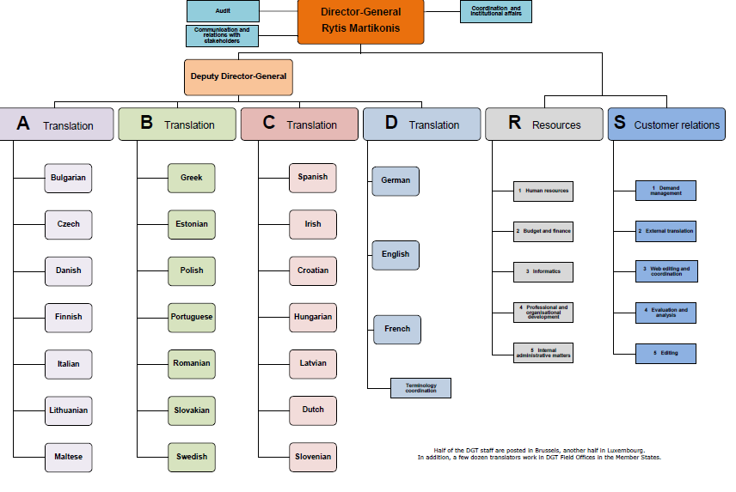

Slide 12
External Translation Unit
Sektori:
• Iepirkumi un līgumi
• Pieprasījumi un pasūtījumu noformēšana
• Rēķini un maksājumi
• Kvalitātes uzraudzība
Notes:
12
Procurements and contracts
• Outsourcing requests and order forms
• Invoices and payments
• Follow up on quality issues

Slide 13
Framework contract
OMNIBUS-15
Ietvarlīgumi (noteiktā secībā)
Nav garantēts minimālais apjoms
FL var atteikt (neņemt) darba piedāvājumus
Kopējais maksimālais ilgums - 4 gadi
Notes:
13
Multiple framework contracts in cascade
No minimum volume guaranteed
FL free to refuse jobs
Total duration 4 years maximum

Slide 14
Tender OMNIBUS-15
EN=>LV
15 līgumslēdzēji (13 uzņ., 2 indiv.)
FR=>LV
3 līgumslēdzēji (uzņ.)

Slide 15
Darba uzdevums ārštata tulkošanai
Sagatavo tulkošanas nodaļas: vadītājs, sekretāri, tulkotāji (rediģētāji), vispārīgas norādes
termiņš, instrukcijas, pievienotie/atsauces dokumenti, rediģētājs
DGT
ārštats
svarīgi nodot visu informāciju tulkotājam!
svarīgi jautāt, ja neskaidrības

Slide 16
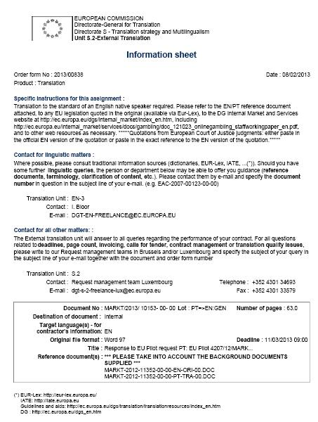


JAUNS DARBS:
PIRMS TULKOŠANAS
Pārbaudīt visus dokumentus!
  Oriģināls
  References dokumenti
  Informācijas lapa:
    lapu skaits
    termiņš (datums & laiks)
    cita būtiska informācija
    (formāts, terminoloģija u.c.)
    papildinājumi (versijas, daļas)

Slide 17
TULKOŠANAS GAITĀ:
Kvalitāte
Palīgmateriāli
Saziņa
Notes:
Par neskaidrībām, jautājumi par tekstu uc.,eksperti, bibliotēkas…
Q prasības

Slide 18
Ko nozīmē tulkojuma kvalitāte
ES kontekstā?
Pareizība
Vienāda juridiskā ietekme 24 valodās un 28 tiesiskajās sistēmās
Lasāmība
Notes:
There is more to translation quality than absence of errors; a translated text must be easy to read, even if the original is not very clear.
Correct usage of the target language, correct use of subject-specific and EU terminology, consistency with the original and between the different language versions, and compliance with the specific conventions for different types of texts (legal, political, letters, speeches, Web, etc.) => More than straightforward translation errors but focuses instead on the intrinsic quality of the translation: the translation delivered must be precise.

Slide 19
Ko nozīmē kvalitāte ārštata tulkojumu tehniskajā piedāvājumā
3.4.1 Pakalpojuma kvalitāte
Metodes, sistēmas, līdzekļi, pasākumi, kas ļauj
− izvērtēt, akceptēt, piešķirt tulkošanā tekstu;
− nodrošināt pareizību un atbilstību ES tekstu standartam;
− veikt pārbaudes un izmantot DGT atsauksmes;
− pārvaldīt resursus un kompetenci (mācības, kvalitātes uzraudzība, speciālo zināšanu pieejamība, konfidencialitāte);
− pārvaldīt termiņus, nodrošināt izpildi arī neparedzētos apstākļos.
Notes:
3.4.1 Quality of service
− methods for assessing, accepting and (where necessary) assigning texts for translation (20/100);
− means of ensuring the accuracy of translations and compliance with conventions and instructions for EU legal and administrative texts in the target language (20/100);
− pre-release verification and incorporating DGT feedback (20/100);
− resource and competence management – training, quality monitoring, availability of knowledge and expertise, confidentiality (20/100); and
− management of deadlines and methods to ensure compliance with the FWC even under unforeseen circumstances (20/100).

Slide 20
Tender specifications

Slide 21
1.11 Quality requirements
The quality of the translations must be such that they can be used as they stand upon delivery, without any further formatting, revision, review and/or correction by the contracting authority.
To this end, the contractor must thoroughly revise and review the entire target text, ensuring inter alia that:

Slide 22
Framework contract
Kvalitāte
Tulkojums = pārlasīts un rediģēts
Kvalitāte = lietojams uzreiz
Notes:
Bez papilddarbībām, rediģēšanas, papildināšanas…
− ‘review’ means to examine a target text for its suitability for the agreed purpose and
compliance with the conventions of the domain specified in the order form or specific
contract and to make any amendments necessary for this purpose. A review can be a
deliverable for the purposes of the FWC;
− ‘revise’ or ‘revision’ means systematic comparison of the original and target texts
before delivery to ensure that the target text is an accurate and consistent rendering of
the original, that it meets the quality requirements set in these tender specifications and
that any discrepancy between the source and target texts is eliminated. Revision
therefore includes making any amendments necessary for this purpose. A revision can
be a deliverable for the purposes of the FWC

Slide 23
Framework contract
Pamatprasības:
Kvalitāte un termiņš!
Notes:
23
Possible delays in delivery must be reported to the authorising department not later than
48 hours before the deadline for delivery or immediately when the causes of such delays arise

Slide 24
Kvalitātes prasības tulkojumam
• pilnīgs un pabeigts
• atbilstība oriģinālam;
• atsauces un citāti;
• terminoloģija;
• skaidrība, reģistrs, teksta tips;
• bez valodiskām kļūdām;
• formatējums;
• specifiskas norādes;
• termiņš.
Notes:
it is complete (without unjustified omissions or additions);
• it is an accurate and consistent rendering of the source text;
• references to documents already published have been checked and quoted correctly;
• the terminology and lexis are consistent with any relevant reference material and internally;
• appropriate attention has been paid to the clarity and register and text-type conventions;
• it contains no syntactical, spelling, punctuation, typographical, grammatical or other errors;
• the formatting of the original has been maintained (including codes and tags if applicable);
• any specific instructions given by the authorising department are followed; and
• the agreed deadline (date and time) is scrupulously respected.

Slide 25
DGT uzdevums darbā ar ārējo tulk.
Teksta rediģēšana atbilstoši kvalitātes prasībām
Galīgā teksta sagatavošana
Novērtēšana
Kvalitāte VAI termiņš?

Slide 26
Materiālu un norāžu tīmekļa vietne
Guidelines for contractors translating into Latvian:
http://ec.europa.eu/translation/latvian/guidelines
/lv_guidelines_en.htm
(tiek periodiski atjaunināta)

Slide 27
Materiālu un norāžu tīmekļa vietne
General EU information
ES iestāžu tīmekļa vietnes
Tiesību aktu datubāzes
Contractor guides
Terminu datubāzes
Rokasgrāmatas
Language-specific information
Standarttekstu paraugi
Dažas vārdnīcas, terminu saraksti
Saites uz valsts iestādēm

Slide 28
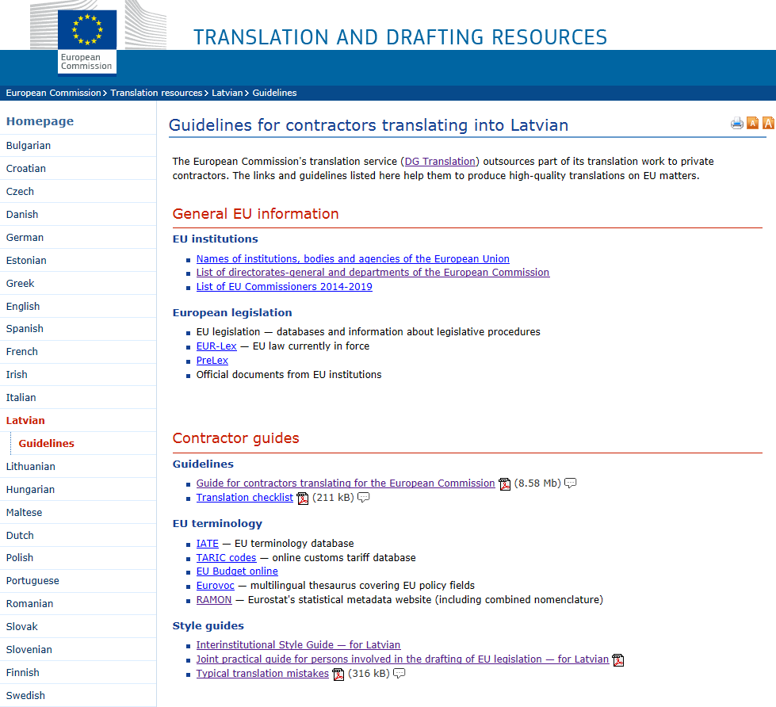

Slide 29
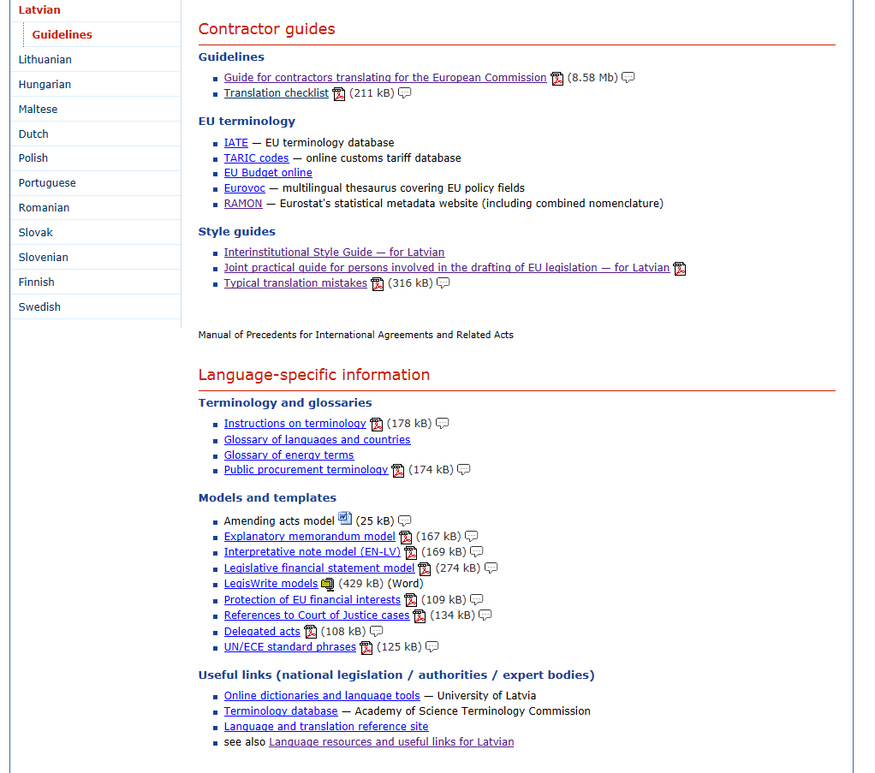

Slide 30
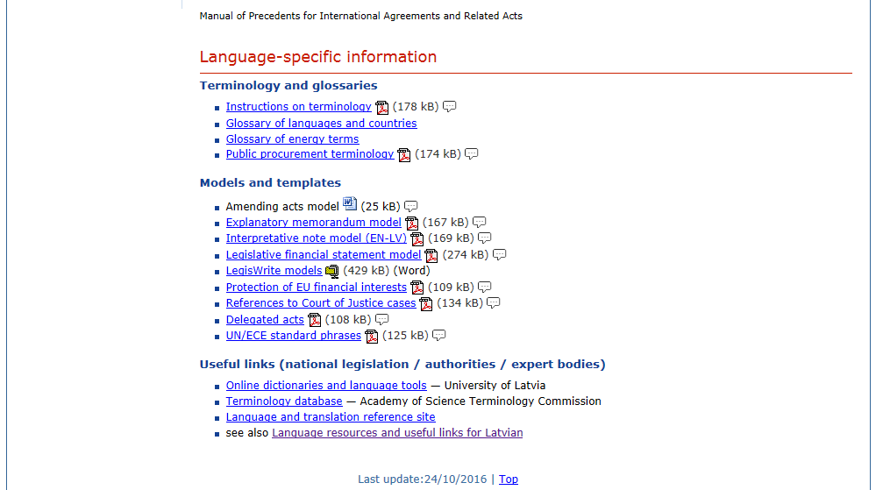

Slide 31
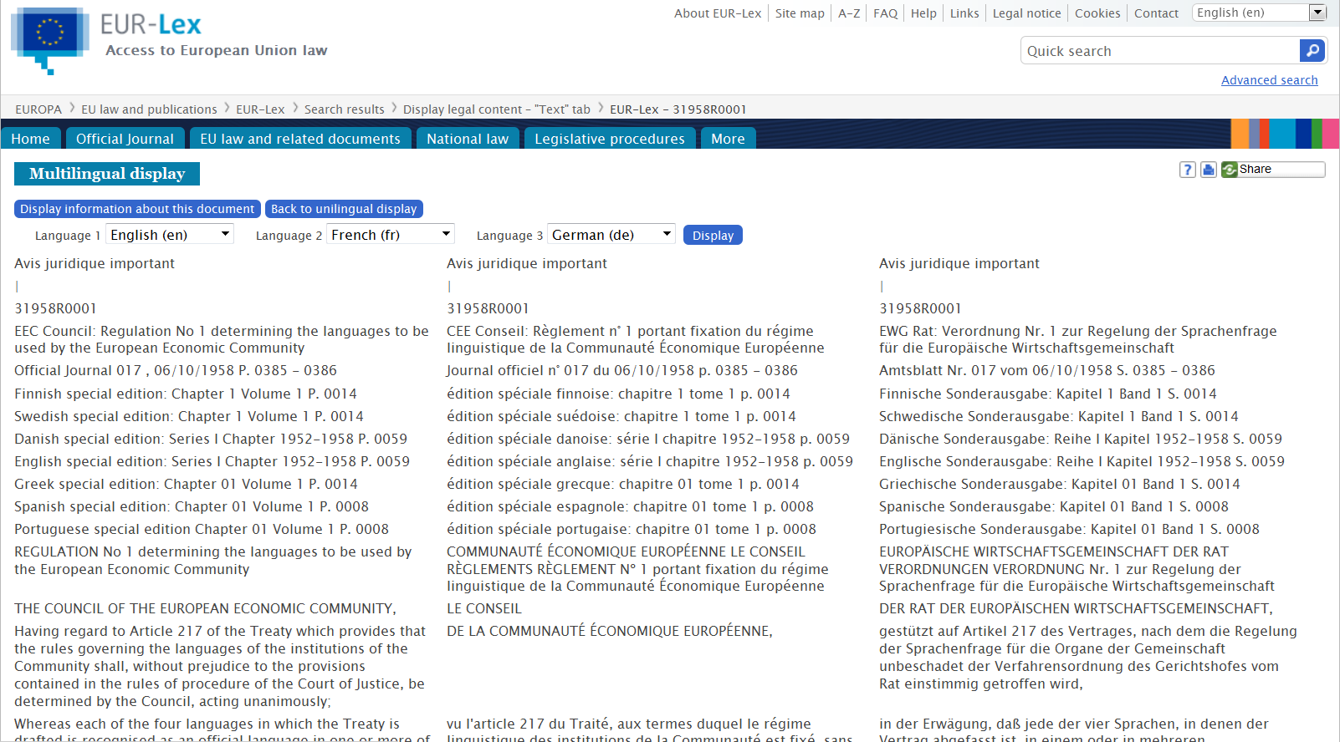
EUR-Lex: free public access to EU law
eur-lex.europa.eu
Notes:
Example: Regulation 1/58 with multilingual display in 3 languages
EUR-Lex provides free access to European Union law and other documents considered to be public. The website is available in 24 official languages of the European Union. You can choose your preferred language from the language bar at the top of the home page.
The contents of the site amount to some 2 815 000 documents, with texts dating back to 1951. The database is updated daily and every year around
12 000 documents are added.
EUR-Lex offers: daily editions of the Official Journal of the European Union online, simple and advanced search, multilingual search, possibility to display and/or download documents (PDF, HTML, DOC, TIFF), analytical metadata for each document.

Slide 32
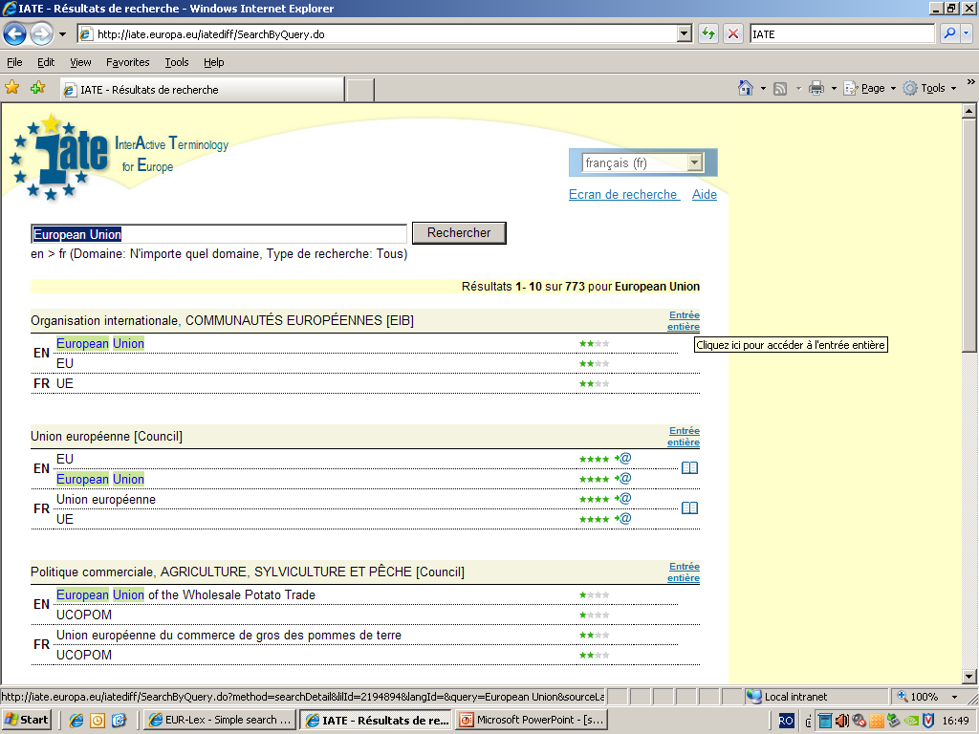
IATE: public multilingual term base
iate.europa.eu
Notes:
Example: the term ‘European Union’ in EN and FR.
IATE (= “Inter-Active Terminology for Europe”) is a shared terminology database of all the EU institutions. It contains around 9 million terms, 0.5 million abbreviations and 0.15 million phrases in all 24 official EU languages, Latin, for botanical and zoological names, plus some other languages. It covers all the fields of activity of the EU and is managed by the EU institutions:
European Commission
Parliament
Council
Court of Justice
Court of Auditors
European Economic and Social Committee and Committee of the Regions
European Central Bank
European Investment Bank
Translation Centre for the bodies of the EU
High interest by the public: Peaks of more than 300 000 queries per day, or above 7 million per month.
Two interfaces: one internal and one publicly accessible from the website http://ec.europa.eu/translation/english/guidelines/en_guidelines_en.htm

Slide 33
Metodiskie materiāli
Nosaukums | Atrašanās vieta
Kopējā praktiskā rokasgrāmata Kopienas tiesību aktu izstrādei | http://eur-lex.europa.eu/content/techleg/EN-legislative-drafting-guide.pdf
Iestāžu publikāciju noformēšanas rokasgrāmata | http://publications.europa.eu/code/lv/lv-000100.htm

Slide 34
Darba instrukcijas I
Standarta (vairumam pasūtījumu):
A) Please respect the format and deadline of the document. B) Please observe the translation guidelines for contractors available at http://ec.europa.eu/translation/

Slide 35
Darba instrukcijas – teksts ar atsaucēm uz tiesību aktiem
Mandatory to use the quoted acts (available on EUR-Lex http://eur-lex.europa.eu) as reference documents, where appropriate. Should you, for a duly justified reason, suggest different wording/term, please send your suggestions/considerations in a separate file of comments.

Slide 36
Darba instrukcijas – tulkošanas atmiņas (xliff exchange) un priekštulkojums
Darba instrukcijas – agrāki tulkojumi
Darba instrukcijas - kļūdas pievienotajos/atsauces dokumentos
Darba instrukcijas – starpniekvaloda
Darba instrukcijas – tehniski aspekti

Slide 37
Tehniskie aspekti – vizuālā atbilsme
    ?
Dental care
Zobārstniecības pakalpojumi

Slide 38
Saziņa starp DGT un ārštata tulkotājiem
"Translator’s and/or reviser’s and/or reviewer’s remarks on terminology, source text content or any other translation issues arising are appreciated.
They are to be submitted in a separate file together with the target text via the eXtra web portal."
Notes:
Ārštata tulkojumu izmantošanas stratēģija

Slide 39
Assistance to contractors
Informatīvi semināri
References dokumenti, tulkošanas atmiņas
Regulāra atsauksmju sistēma
Tiešsaistes terminoloģijas datubāzes
Tiešsaistes dokumentu datubāzes (ES tiesību akti u.c.)
Ārējo tulkojumu nodaļa (FMB)
Ārštata tulkojumu korespondents valodu nodaļās (FMB)
Notes:
39

Slide 40
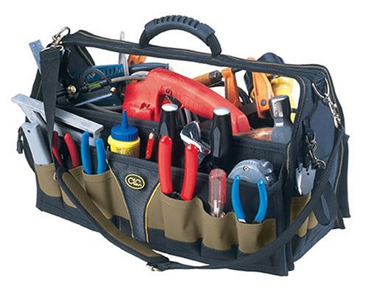
Tradicionālie tulkotāja palīglīdzekļi
  Kontakti ar pasūtītāju/ citiem tulkotājiem
  Kontakti ar speciālistiem Komisijā, citās iestādēs vai dalībvalstīs
  Bibliotēkas
  References teksti
Notes:
Some DGT language departments have set up language-specific cooperation networks with other institutions, national authorities, experts, etc.
Examples: REI for Italian, ESKO for Finnish, STS for Slovak, Lithuanian terminology forum.

Slide 41
Sadarbība ar speciālistiem
  Izpratne par to, kas ir termins
  Speciālistu viedokļu atšķirības
  Konkrēts risinājums pretstatā universālam lietojumam
  Apstiprinātā terminoloģija un ikdienas lietojums
  Konfidencialitāte, profesionālā ētika

Slide 42
Framework contract
Konfidencialitāte
“Treat in the strictest confidence and not make use of or divulge to third parties any information or document”
Mašīntulkošanas ierobežojumi
Notes:
42
google translator forbidden for confidentiality reasons

Slide 43
Sekmīgas sadarbības atslēga
Vienota izpratne par kvalitāti
Saziņa un sadarbošanās
Resursu apzināšana un efektīva izmantošana

Slide 44
Paldies par uzmanību!
http://ec.europa.eu/dgs/translation/
Notes:
44

Slide 45
FL funkcionālās pastkastes:
DGT-LV-FREELANCE@EC.EUROPA.EU
(teksts, saturs, valodas jaut.)
dgt-s-2-freelance-lux@ec.europa.eu
dgt-s-2-freelance-brux@ec.europa.eu
(tehniski jaut., līguma nosacījumi)

Slide 46
DGT-LV-INTERINST@ec.europa.eu
(ES tulkojumu kvalitātes jautājumi)
iveta.rancane@ec.europa.eu

